Slide 1
Index
What is a Version Control System
Why use VCS
Types of VCS
Glossary/Concepts
Git: main features, workflows, resources
How to use a Version Control System (GitHub)

Slide 2
Version Control in a nutshell
A Version Control System (VCS) is a system that keep track of changes in files.
It can be either centralized or distributed
It can be used to enable simple collaboration in projects involving multiple people

Slide 3
Why use a VCS
Why use a VCS?
Keep track of changes in files, author and time of the change
Storage efficiency (delta compression)
Multiple people can edit a file at the same time
Different users can have different permissions (ACL)
Branching allows you to keep indipendent versions of files
It makes easy to compare different versions of files
IDE/Editor integration
Why not to use a VCS?
Binary files (git-lfs)

Slide 4
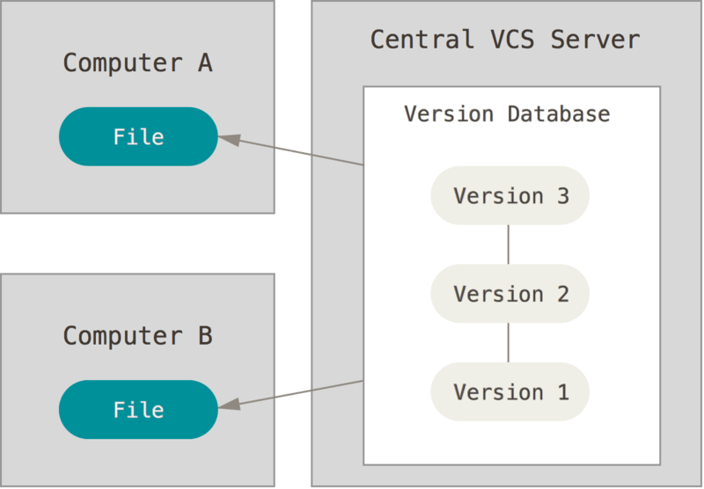
Centralized VCS
One Truth
Client-Server approach
Central server contains the whole history while clients only have a single version of each file
Branches, tags, etc are centralized
Examples:
Subversion (SVN)
Concurrent Versions System (CVS)
Team Foundation Server (TFS)

Slide 5
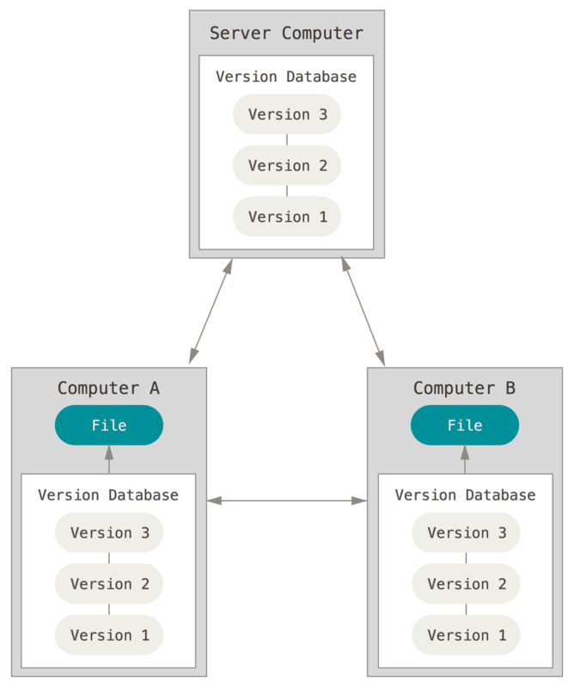
Distributed VCS
Many Truths: each repository is as good as the others
Peer-to-peer approach
Every client is a full repository: it has the whole history of files, every branch and tag
Supports local branches and tags
Examples:
Git
Mercurial (Hg)
BitKeeper
Bazaar

Slide 6
Glossary/Concepts (basics)
init | Creates a new Repository
Repository | Where files and historical data are stored
Working copy | Local copy of files
clone, checkout | Downloads a working copy from a repository
update, pull | Merge changes from Repository
add, rm, mv | Schedule the insertion, removal, movement of a file to/from the repository
commit, check-in | Write operation from working copy to repository
Repository
Working copy
clone, checkout, update, pull
add, rm, mv, edit
Modify working copy
status, diff
commit, push
Review changes

Slide 7
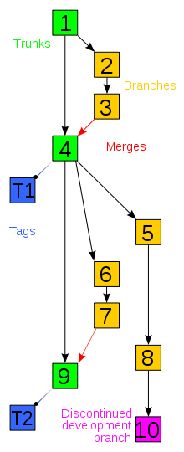
Glossary/Concepts (branching)
branch | An indipendent version of a set of files
tag | A pointer to a ‘snapshot’ of the repository
Merge | merge repository changes to working copy

Slide 8
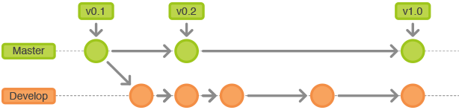
Branching workflows
Long-Running Branches
Stable code in master branch
Development takes place in a development branch
Development branch is integrated periodically on master

Slide 9
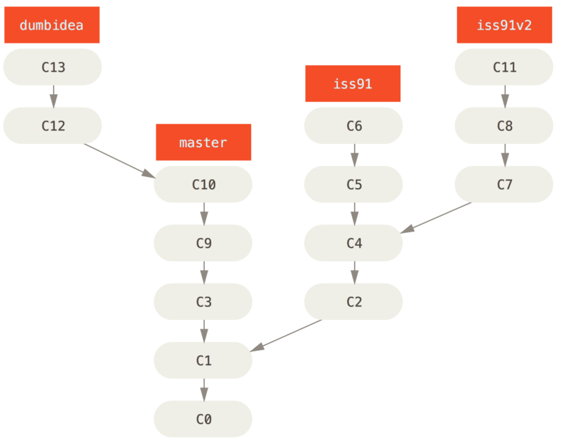
Branching workflows
Topic/Feature Branches
Each new feature/idea has its own branch
Features get merged to master as they become stable.

Slide 10
Git
Git is an open source Distributed Version Control System created by Linus Torvalds (2005) after free use of BitKeeper was withdrawn.
Main features:
Distributed development: every user has a full local copy of the repository.
Non-linear development: fast branch and merge operations.
Cryptographic authentication of history: the ID of a commit depends upon the history leading up to that commit.
Efficient and scalable: nearly all operations are performed locally, efficient storage.
Use of existing protocols: HTTP, FTP, SSH
«I’m an egoistical bastard, and I name all my projects after myself. First ‘Linux’, now ‘git’»
Linus Torvalds

Slide 11
Git
Resources:
Learn Git (interactive tutorial):
try.github.io
Git repository hosting:
github.com
gitlab.com
Git cheat sheet:
https://services.github.com/on-demand/downloads/github-git-cheat-sheet.pdf
Git cheat sheet (interactive):
http://ndpsoftware.com/git-cheatsheet.html
Reference book (Pro Git):
https://git-scm.com/book/en/v2

Slide 12

GitHub
«GitHub is a web-based Git or version control repository and Internet hosting service.» Wikipedia
Features:
Access control
Issues tracking
Wiki
Pull requests

Slide 13
GitHub Flow
GitHub’s best supported workflow is Topic branches (https://guides.github.com/introduction/flow)
Create a branch
Commit changes
Open a Pull request
Discuss and review your code
Deploy and Merge into master

Slide 14
GitHub Demo
GitHub’s Hello World project: https://guides.github.com/activities/hello-world/
DEMO
Create a new project (fork from https://github.com/lucazaga/corsoing20172018)
Create a branch
Edit a file and commit changes
Open a Pull request
Merge into master

